Slide 1


TEAMORBIT: AN ONLINE SOFTWARE PROJECT AND TEAM MANAGEMENT SYSTEM
SIMATS ENGINEERING
SAVEETHA INSTITUTE OF MEDICAL AND TECHNICAL SCIENCES
CSA1003 - SOFTWARE ENGINEERING
Presented By :
Under The Supervision :
Dr. T M Usha
K Y V Satyanarayana Reddy(192472157)
V. Deva chary(192465041)
K .Saikiran(19242528)
P. Muni Karthik(192425061)

Slide 2


ABSTRACT
TeamOrbit is an online software project and team management system developed to centralize project activities.
The system manages users, roles, teams, projects, tasks, schedules, and project progress.
It provides role-based access for Admin, Manager, and Team Member users.
Managers can create and assign tasks with priorities and deadlines.
Team members can update task status based on their work progress.
The system is supported by tools such as GitHub, Jira, Figma, Confluence, and Vercel.

Slide 3
INTRODUCTION
Software projects require effective coordination of people, tasks, schedules, and project information.
Manual project management can make task tracking and progress monitoring difficult.
TeamOrbit provides a centralized web-based platform for managing software project activities.
The project follows an Agile-oriented approach for planning, development, testing, documentation, and deployment.

Slide 4
OBJECTIVES
Develop a centralized online platform for software project management.
Provide secure user registration and login.
Implement role-based access for Admin, Manager, and Team Member users.
Provide team and project management capabilities.
Enable task creation, assignment, scheduling, and status tracking.
Calculate and display project progress.
Support Agile planning, documentation, testing, and deployment activities.

Slide 5
PROBLEM STATEMENT
Managing software projects manually can make task allocation and tracking difficult.
Project information may become scattered across different methods of communication and documentation.
Tracking task status and overall project progress can be time-consuming.
User roles and responsibilities need controlled access.
Managers require better visibility into team workload and project progress.
A centralized online system is required to organize project and team activities efficiently.

Slide 6
PROPOSED SYSTEM
Team Orbit Proposed Solution
Centralized web-based project management platform.
Users access the system according to their assigned roles.
Managers manage teams, projects, and tasks.
Team members view assigned tasks and update task status.
Task completion contributes to overall project progress.
Project information is maintained in a centralized database.
The system provides a structured workflow from project creation to task completion.

Slide 7
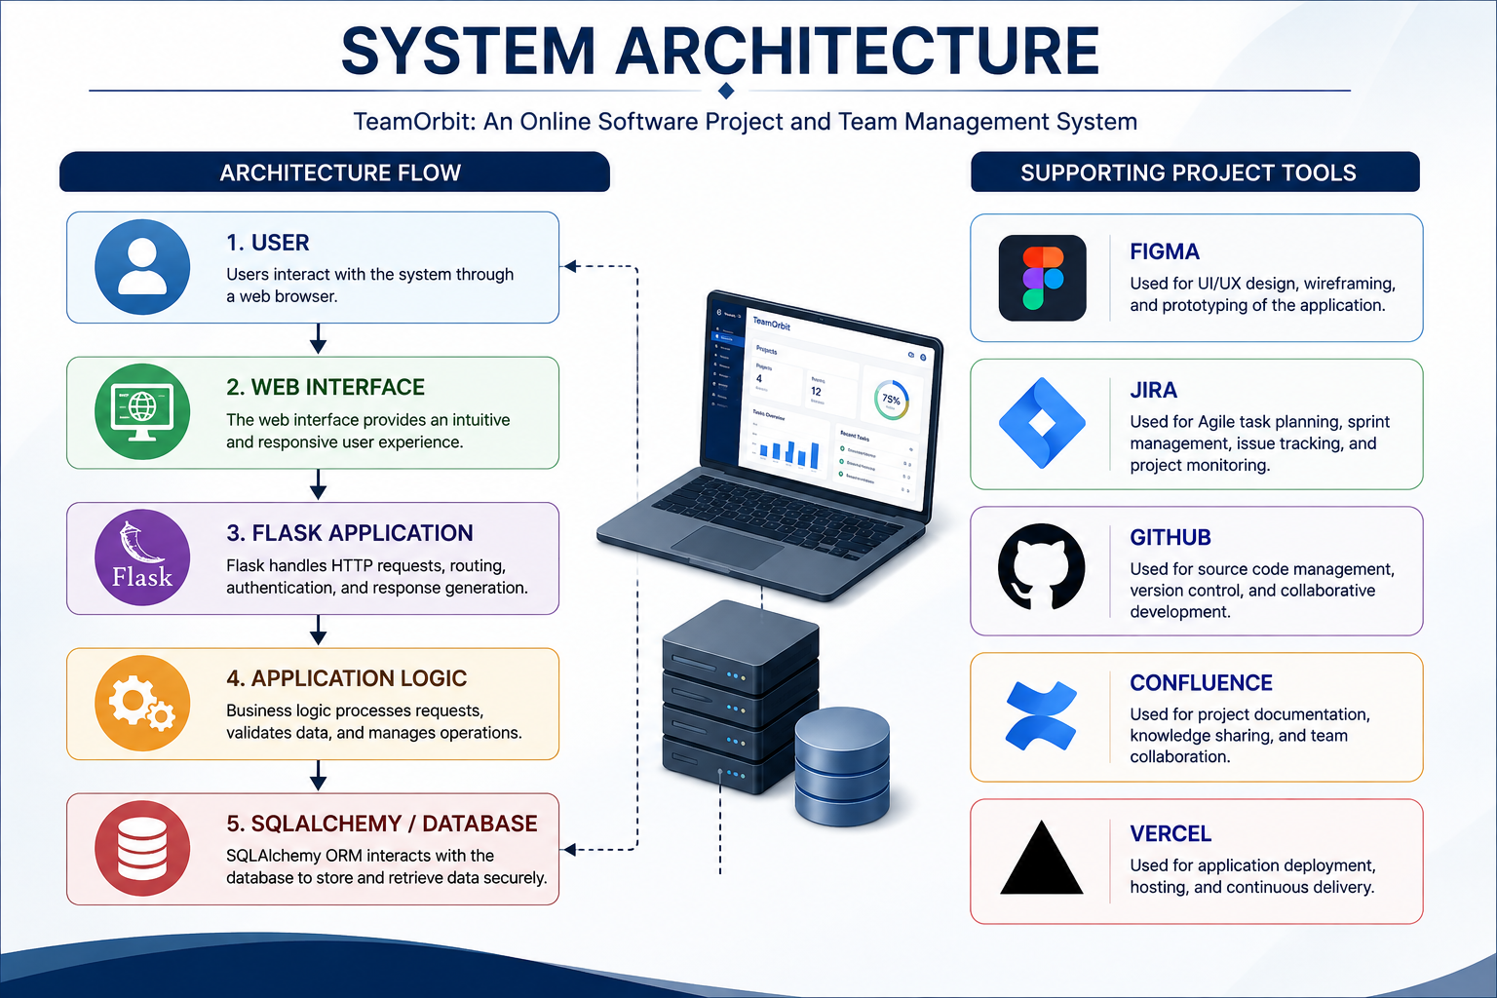

Slide 8
MODULE 1 - REQUIREMENT PLANNING & SRS
Overview
Identifies the requirements of the TeamOrbit system.
Defines the project scope, objectives, and expected functionality.
Identifies the needs of Admin, Manager, and Team Member users.
Defines functional and non-functional requirements.
Documents the system requirements through the Software Requirements Specification.
Activities
Requirement identification
Requirement analysis
User-role identification
Functional and non-functional requirement definition
SRS preparation

Slide 9
MODULE 2 - USER, TEAM & ROLE MANAGEMENT
Overview
Manages users and their access to TeamOrbit.
Supports Admin, Manager, and Team Member roles.
Provides role-based access to system functionality.
Supports team creation and team-member management.
Ensures users can perform operations according to their assigned roles.
Activities
User registration and login
Role creation and management
Role-based access control
Team creation
Team-member management

Slide 10
MODULE 3 - TASK ALLOCATION & SCHEDULING
Overview
Provides task management within TeamOrbit projects.
Managers can create and assign tasks to team members.
Tasks can be assigned priorities and deadlines.
Team members can update task status.
Task status supports the project workflow.
Activities
Task creation
Task assignment
Priority setting
Deadline scheduling
Task status updating

Slide 11
MODULE 4 -AGILE TESTING, DEPLOYMENT & REVIEW
Overview
Tests the implemented TeamOrbit features.
Performs manual functional testing of individual system features.
Verifies integration between related system functions.
Identifies and corrects implementation errors.
Verifies deployment of the application.
Reviews usability and operational behaviour after deployment.
Activities
Functional testing
Integration testing
Error identification and correction
Deployment verification
Usability review

Slide 12
TOOLS USED
Development & Project Tools
Tool | Purpose
Python / Flask | Backend application development
SQLAlchemy | Database interaction
GitHub | Source code management
Figma | UI/UX design
Jira | Agile project management
Confluence | Project documentation
Vercel | Deployment

Slide 13
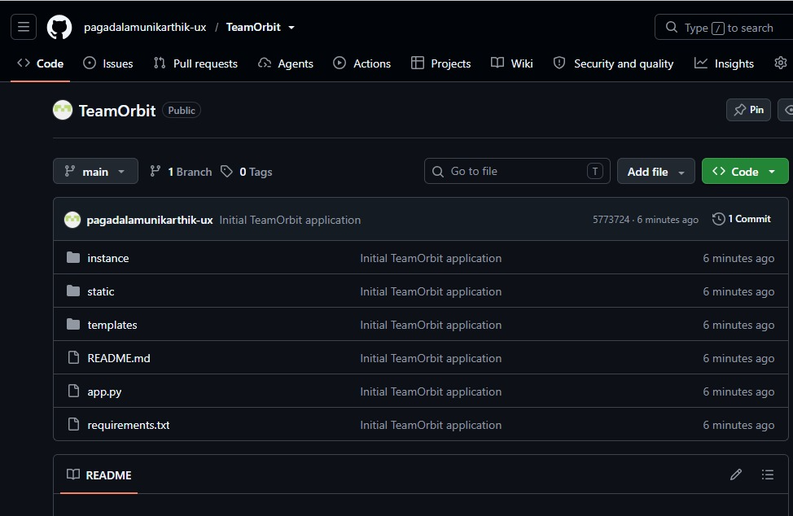
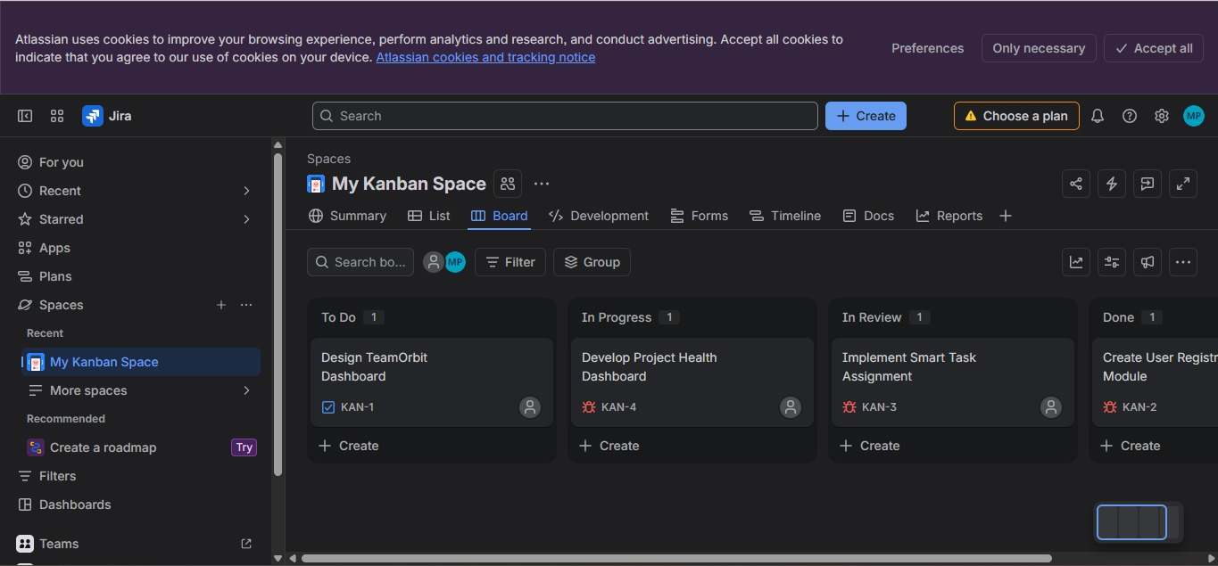
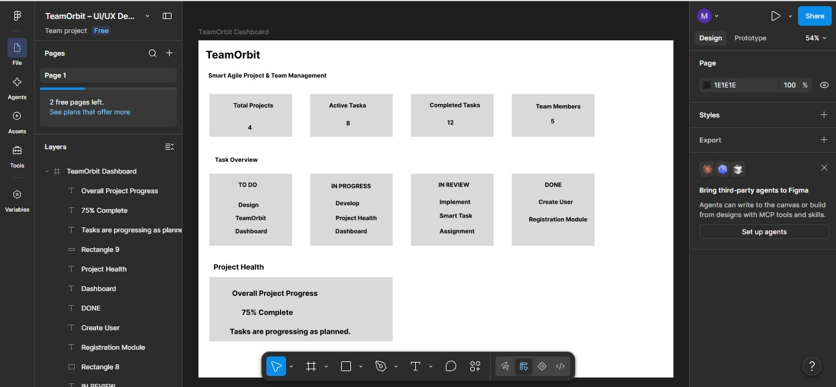
GitHub – Source Code Repository Evidence
Jira Kanban Board activity
Figma_TeamOrbit_Dashboard

Slide 14
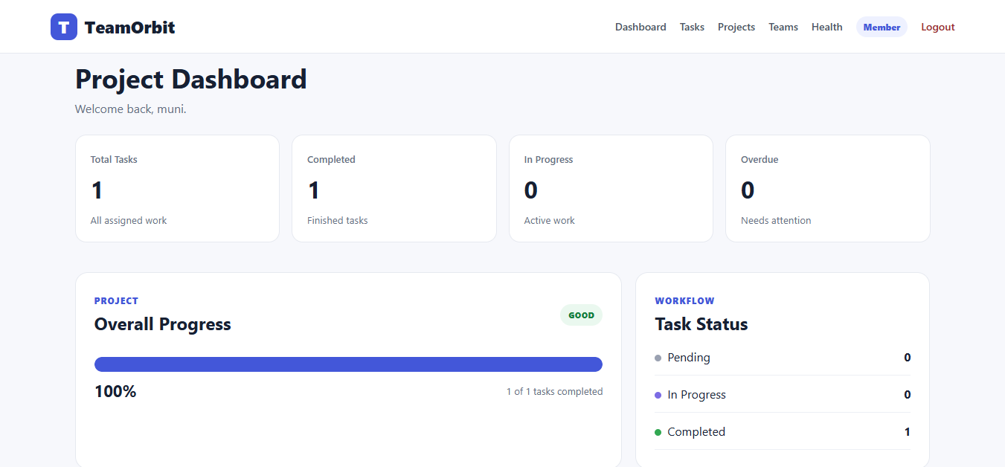
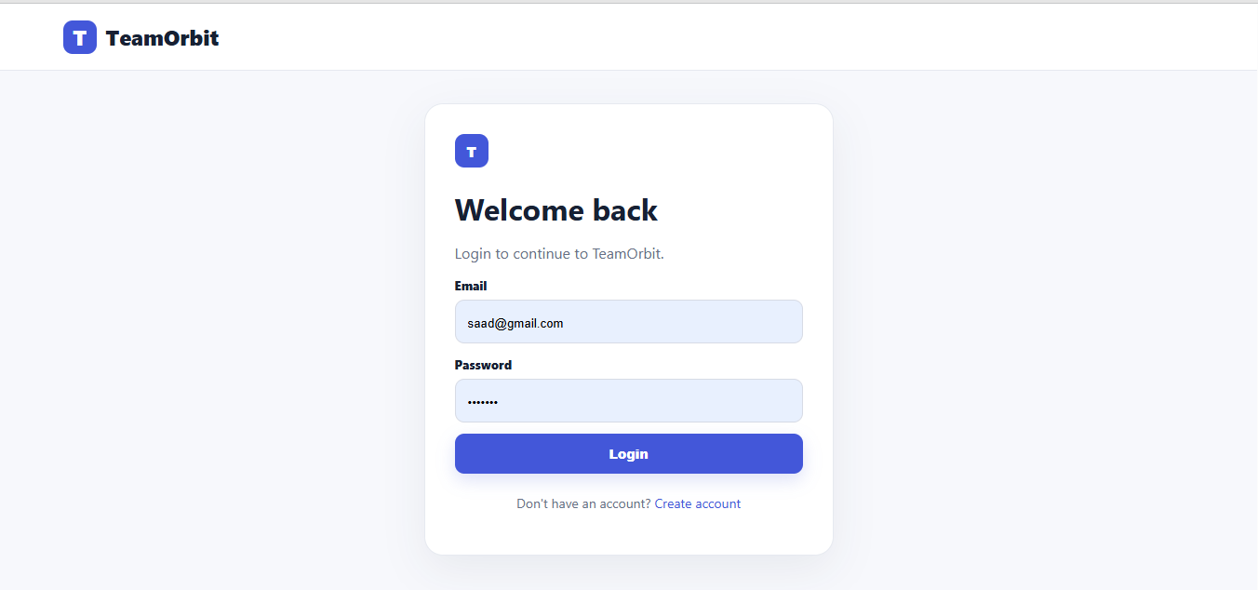
IMPLEMENTATION OUTPUT

Slide 15
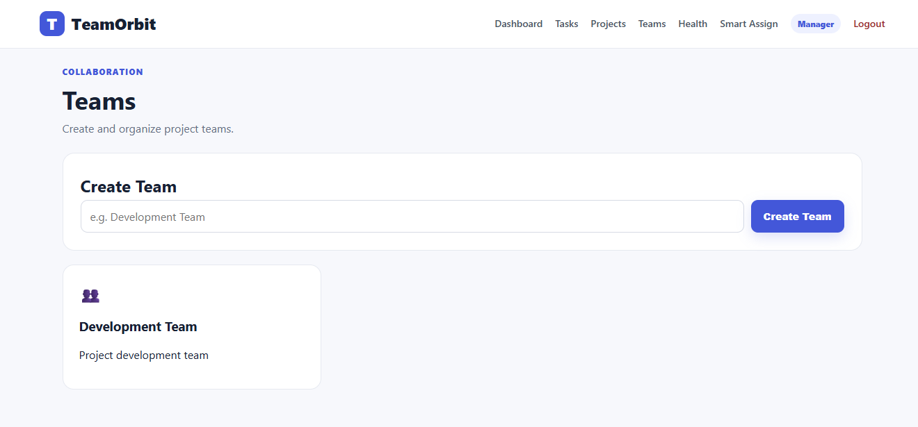
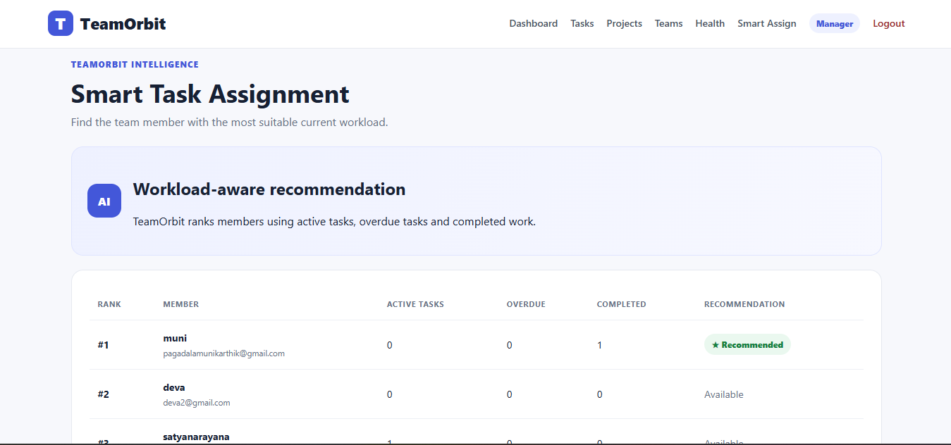
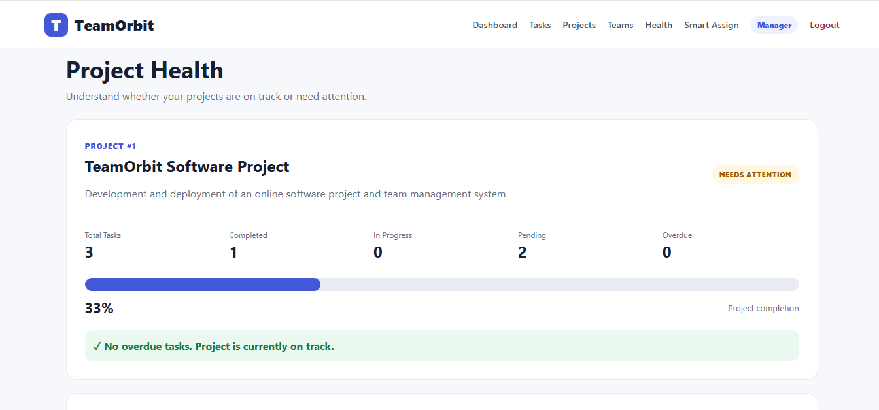

Slide 16
IMPLEMENTATION
TESTING & RESULTS
Web-based TeamOrbit application
Role-based user access
Database-backed project information
Task and project management workflow
Online deployment
User registration and login
Task creation
Task assignment
Task status update
Project progress verification
Module integration
Deployment verification
Usability review

Slide 17
RESULTS
Implemented workflows were tested successfully.
User and role management functions operate as intended.
Task creation and assignment workflows were verified.
Task status changes are reflected in project progress.
Deployment was verified for online access.
The system provides centralized management of project activities.

Slide 18
CHALLENGES & LIMITATIONS
Challenges
Coordinating different project management activities.
Implementing role-based access correctly.
Managing relationships between users, teams, projects, and tasks.
Ensuring task status changes correctly affect project progress.
Identifying and correcting implementation errors during testing.
Limitations
The system is designed primarily for academic/project-level use.
Large-scale production performance and load testing were not performed.
Advanced automated testing can be considered for future enhancement.

Slide 19
CONCLUSION & FUTURE WORK
Conclusion
TeamOrbit provides a centralized platform for software project and team management.
It integrates user, team, project, task, scheduling, and progress-management functions.
Role-based access supports controlled system usage.
Task tracking and progress monitoring improve project visibility.
Testing and deployment activities verified the implemented system workflows.
Future Work
Automated unit and integration testing
Advanced performance and load testing
Additional project-management capabilities
Further improvements to usability and scalability

Slide 20
REFERENCES
K. Beck et al., “Manifesto for Agile Software Development,” Agile Alliance.
R. S. Pressman and B. R. Maxim, Software Engineering: A Practitioner’s Approach, 8th ed., McGraw-Hill.
I. Sommerville, Software Engineering, 10th ed., Pearson.
Flask Documentation, Pallets Projects.
SQLAlchemy / Flask-SQLAlchemy Documentation.
GitHub Documentation.
Jira Documentation.
Confluence Documentation.
Figma Documentation.
Vercel Documentation.

Slide 21
THANK YOU!

